Slide 1
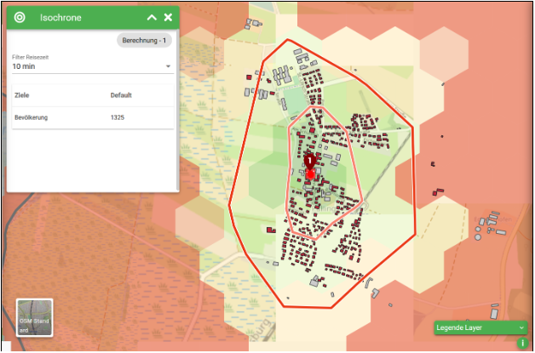
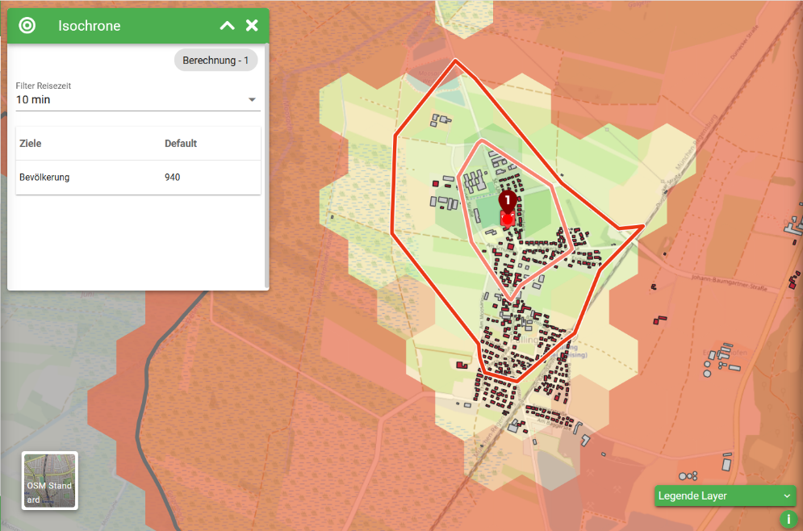
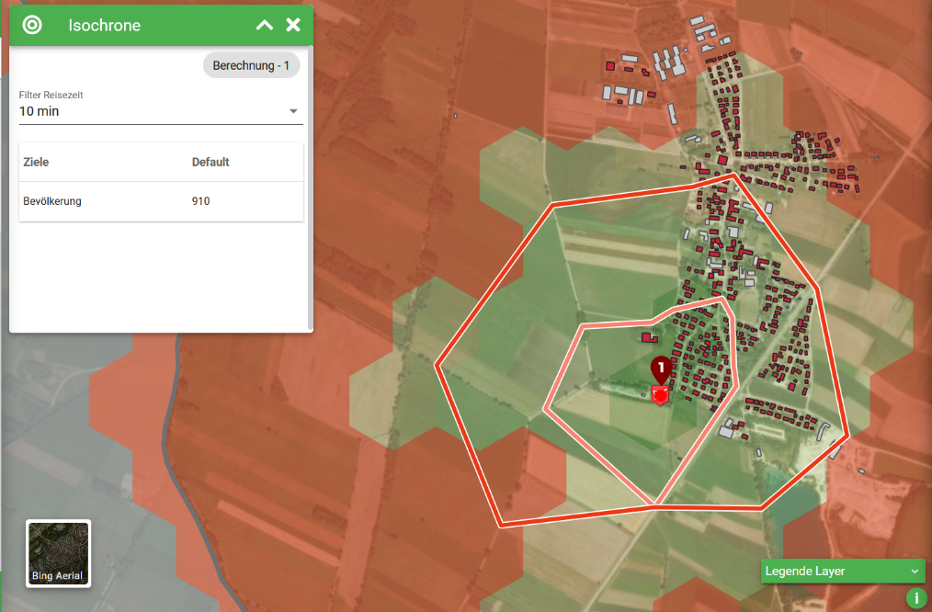
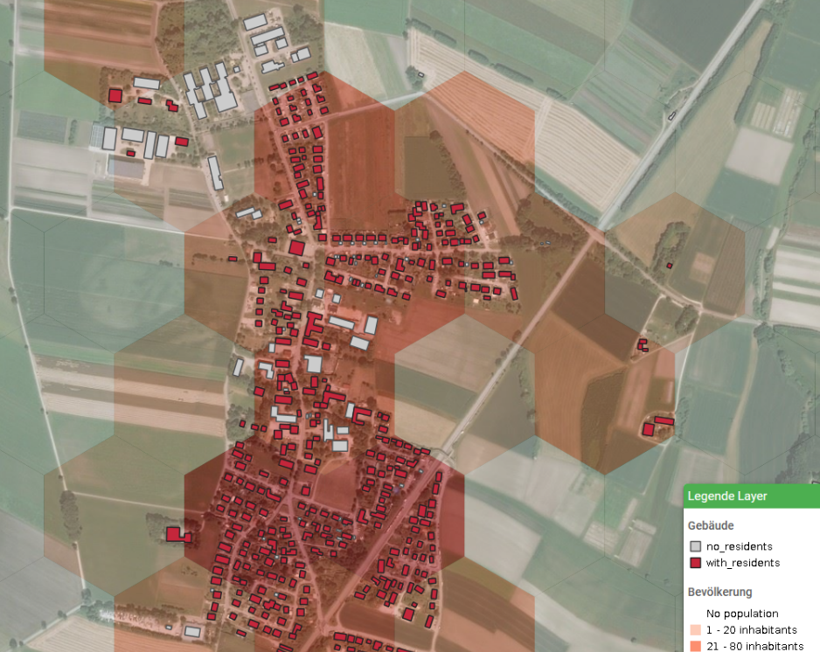
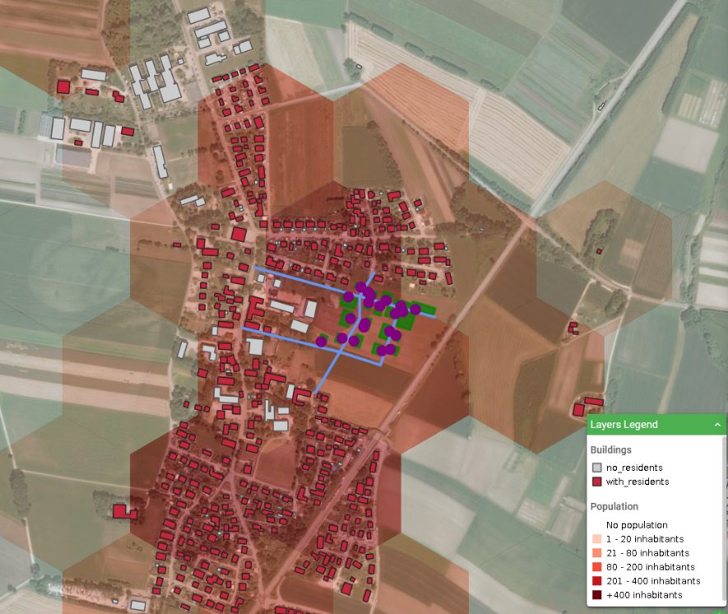

Planning question: Densification of a village
1. Description of the planning question
A village district is to be densified and served with local supply. For this purpose, a “local development concept” was drawn up.
Following questions will be answered with the help of GOAT:
Where is the best location for a new grocery store?
How does the population structure change due to the densification of the areas?
2. Analysis
Where is, based on the current population, the best location for a new grocery store?
method: calculation of isochrones shaping the 10-minutes walking catchment areas
1330 inhabitants can reach the store
940 inhabitants can reach the store
910 inhabitants can reach the store
Location 1
Location 2
Location 3
→ Location 1 has the best accessibility. Nearly all 1400 inhabitants can reach this location within 10 minutes walking.
B. How does the population structure change due to the densification of the areas?
method: scenario building and analyzing the dynamic heatmaps on population
1400
inhabitants
+ 300 inhabitants
BASE
SCENARIO
→ Around 300 new residents will potentially be settled in the eastern party of the village. This will close the currently unsettled gap in the middle of the village.
C. Where is, based on the future population, the best location for a new grocery store?
method: scenario building and calculation of isochrones shaping the 10-minutes walking catchment areas
1630 inhabitants can reach the store
1240 inhabitants can reach the store
910 inhabitants can reach the store
Location 1
Location 2
Location 3
→ Taking into account the planned development area with 300 residents, Location 1 still proves to be the location with the best accessibility. Nearly all 1700 future inhabitants can reach this location within 10 minutes walking.
3. Results:
Grocery store Location 1 brings the best accessibility, for the current population as well as for the future population by taking into account the planned development areas.
The railway line is the main barrier in this area, which highly influences walking accessibility. Location 1 is quite close to the railway crossings and thus also provides a good accessibility for the residents living on the other side of the railway line.
The planned development areas fit in well with existing structures and close the gap in population density and the road network.

